Slide 1
BAND REJECT FILTER

Slide 2
Band Reject Filter/ Band Stop/ Band Elimination Filter
In this filter ckt, frequencies are attenuated in the stop band and passed outside this band.
wide and
narrow band reject .

Slide 3
Wide Band Reject Filter
Fig. (a) shows wide band reject filter circuit using a low pass filter, a high pass filter and a summing amplifier.
For a proper band reject response,
the low cutoff frequency f_{L} of the high pass filter must be larger than the high cutoff frequency f_{H} of the low pass filter.
Also, the pass band gain of both high pass and low pass sections must be equal.

Slide 4
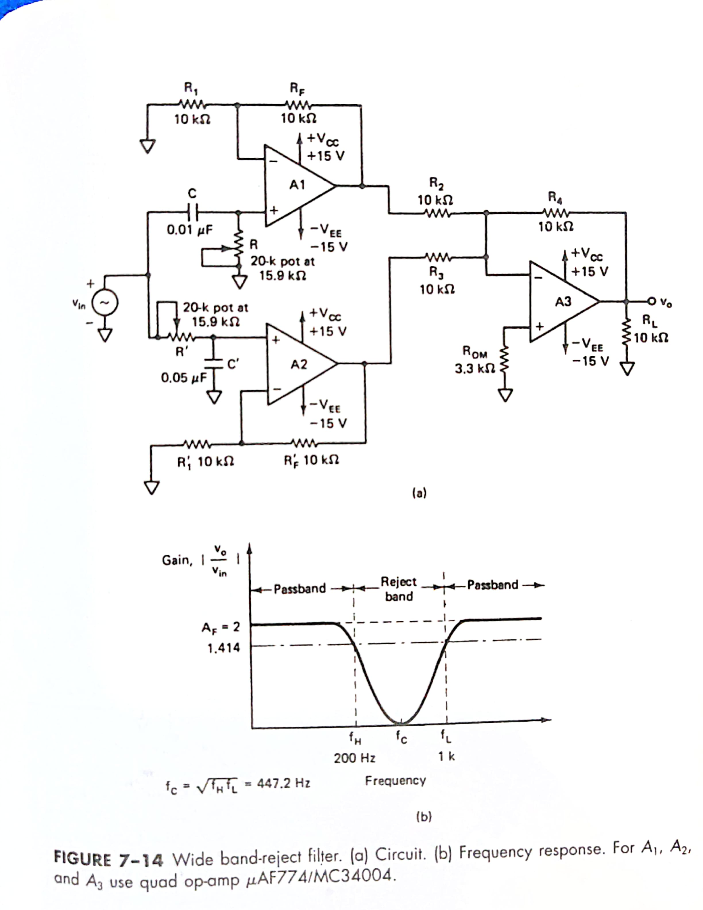

Slide 6
Design a wide band reject filter having f_{H} = 200Hz and f_{L} = 1 KHz.

Slide 7
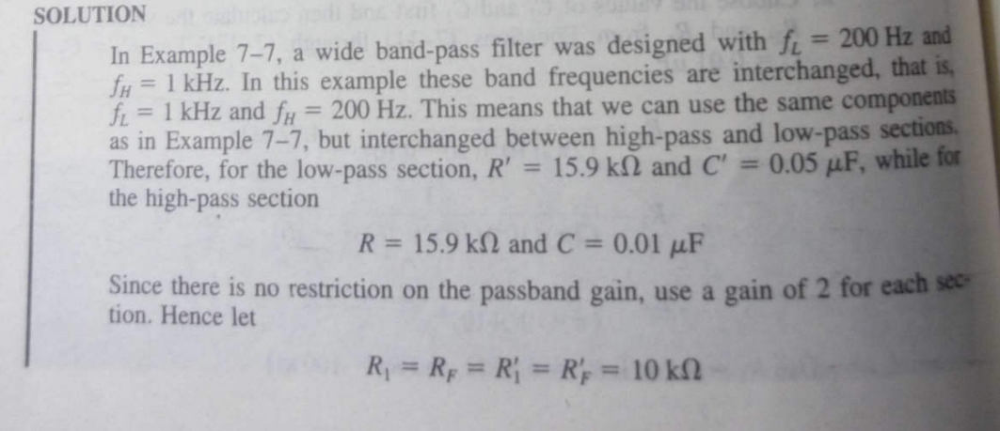

Slide 8
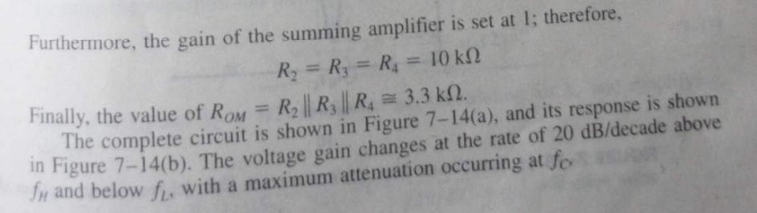

Slide 9
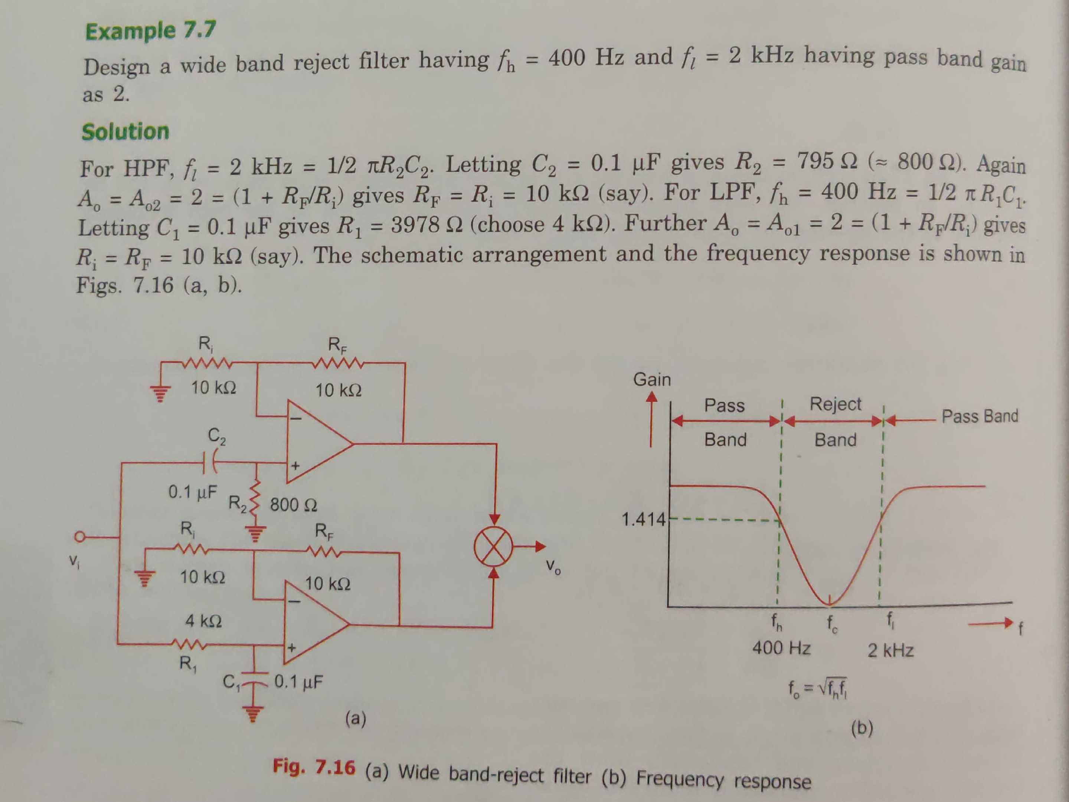

Slide 10
Narrow Band Reject Filter
Also called the notch filter.
commonly used for the attenuation of a single frequency.
For eg:, it may be necessary to attenuate 60 Hz or 400 Hz noise or hum signals in a circuit.

Slide 11
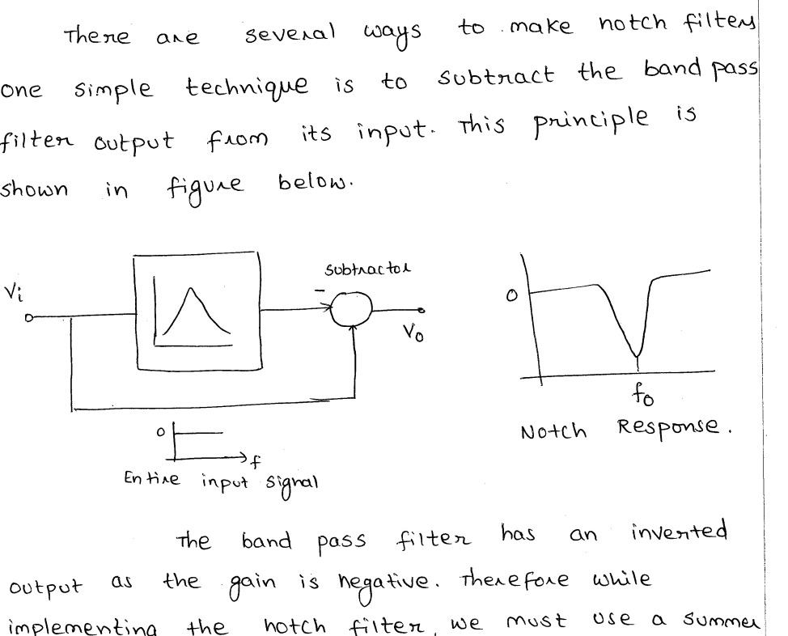

Slide 12
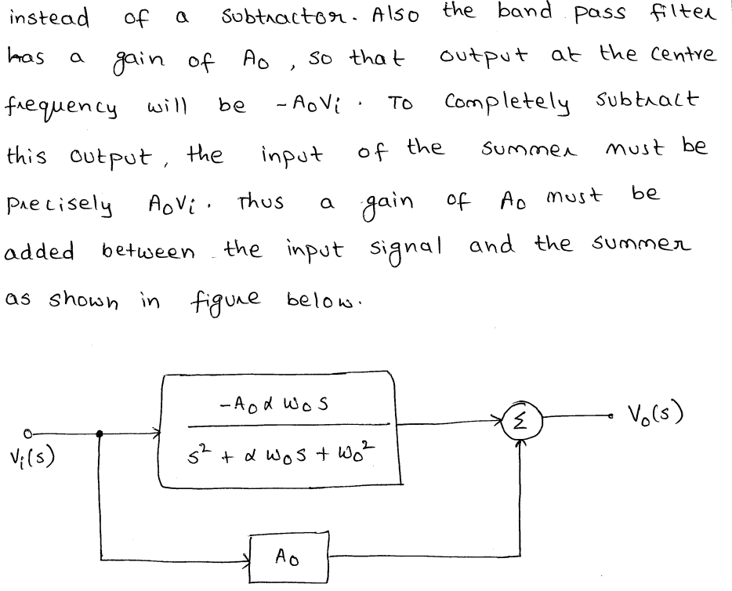

Slide 13
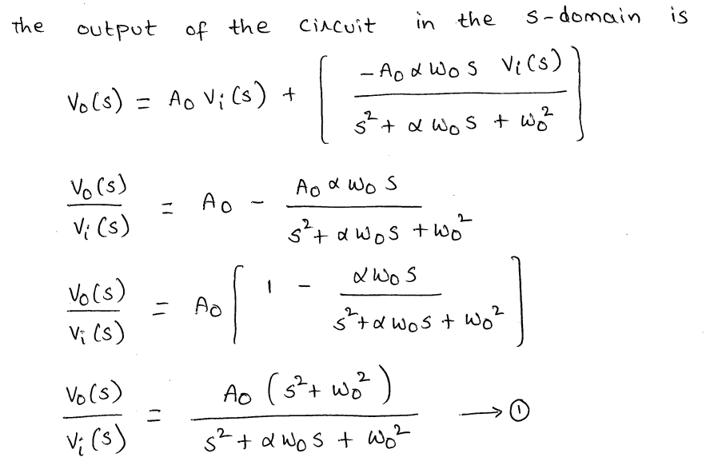

Slide 14
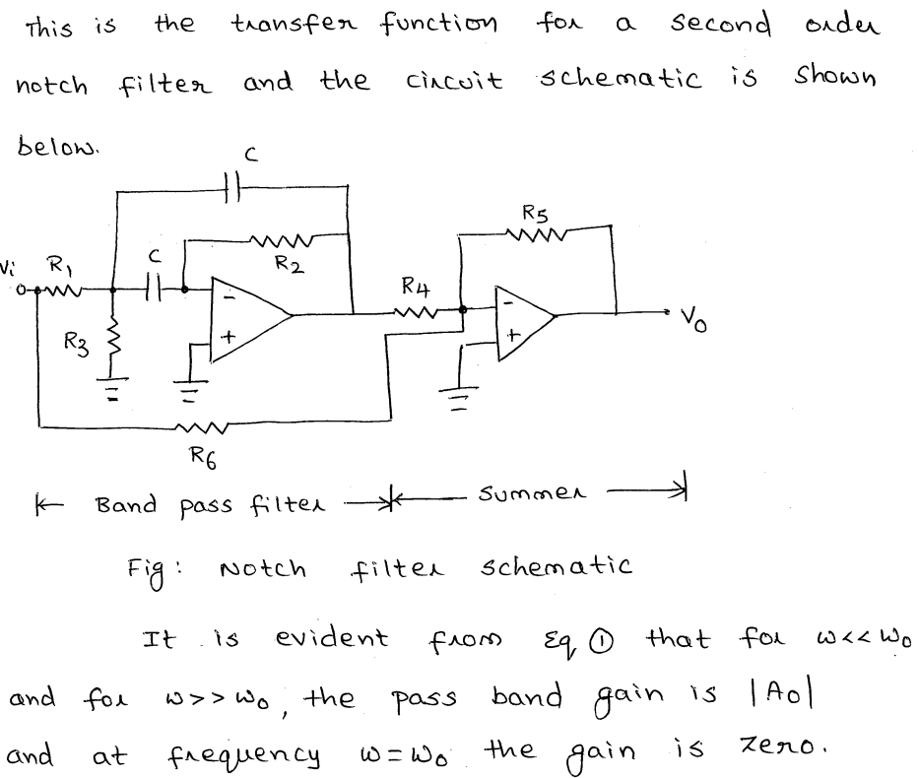

Slide 15
Another commonly used notch filter is the twin-T network as shown in Fig.
One T network is made up of two resistors and a capacitor, while the other is made of two capacitors and a resistor.
We will determine the notch frequency, Q factor and bandwidth for this configuration.

Slide 16
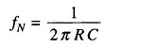
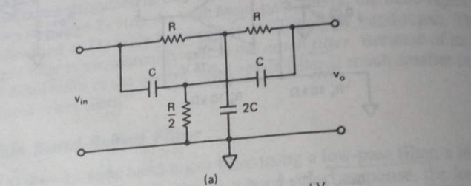
The frequency at which maximum attenuation occurs is called the notch-out frequency, given by

Slide 17
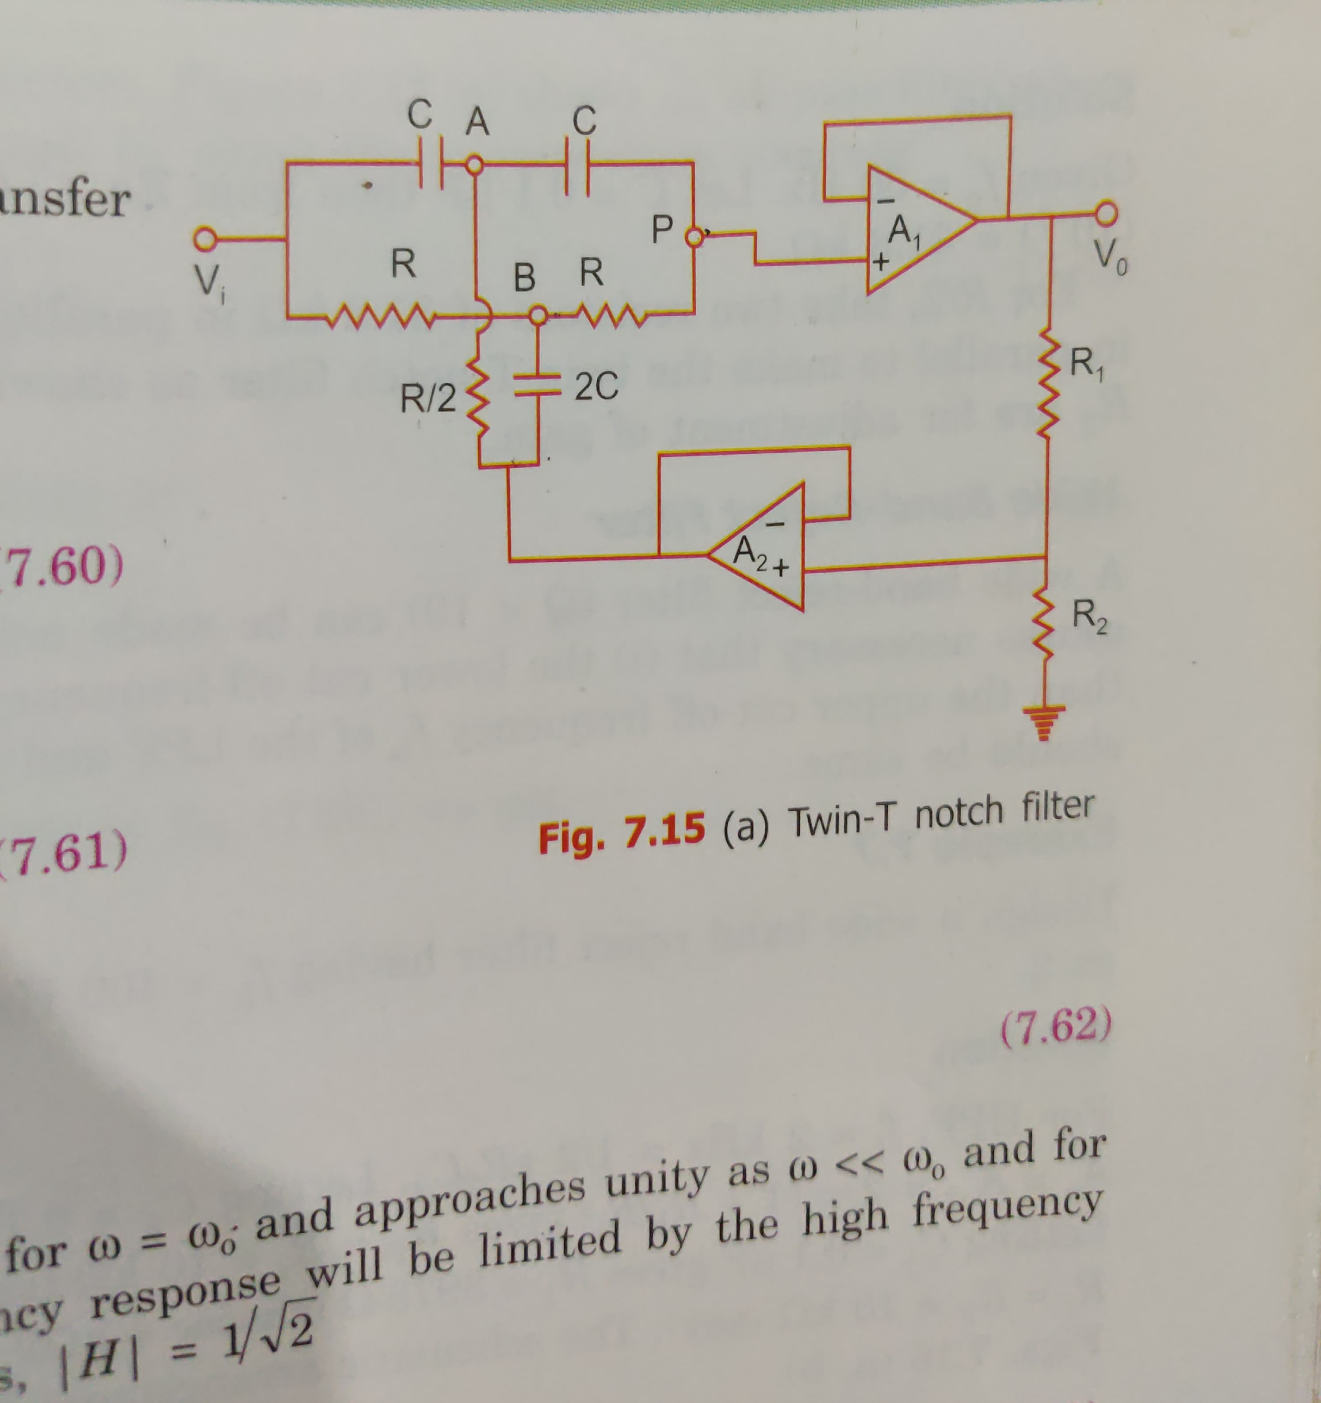

Slide 18
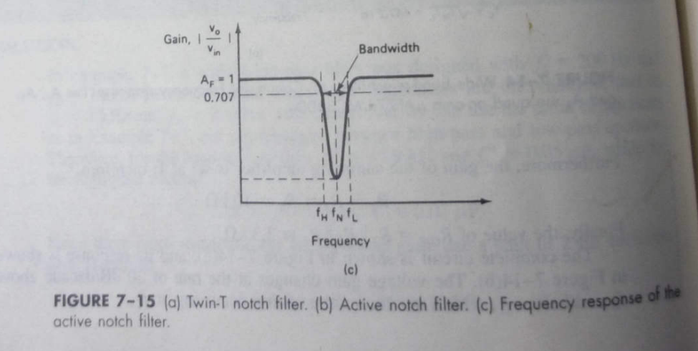

Slide 19
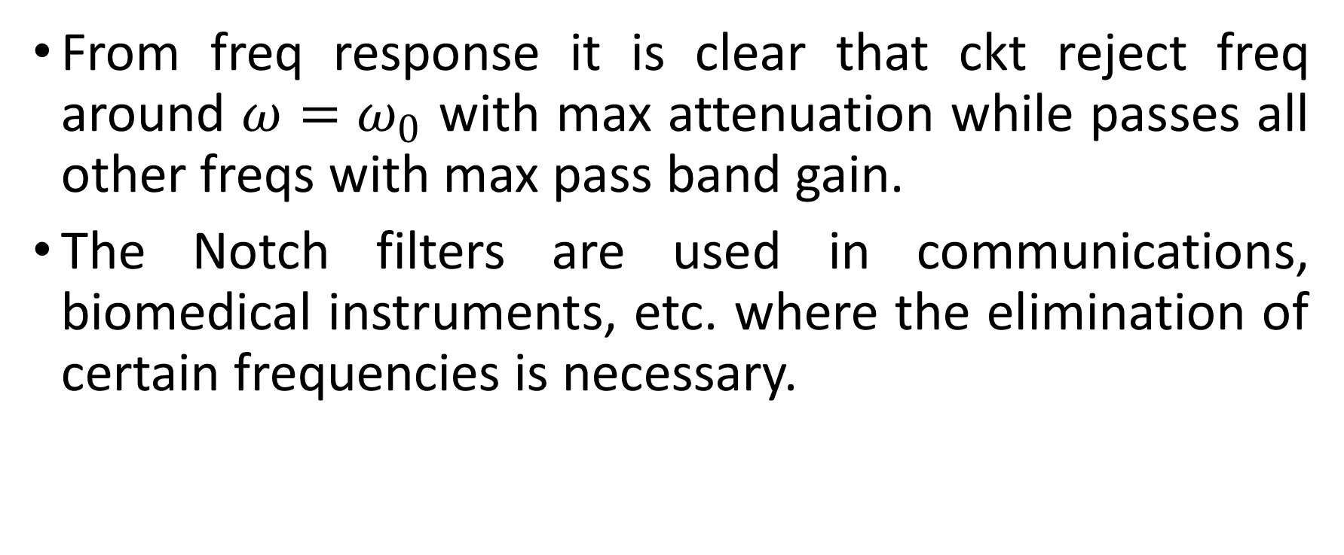
From freq response it is clear that ckt reject freq around $ω=ω_{0}$ with max attenuation while passes all other freqs with max pass band gain.
The Notch filters are used in communications, biomedical instruments, etc. where the elimination of certain frequencies is necessary.

Slide 20
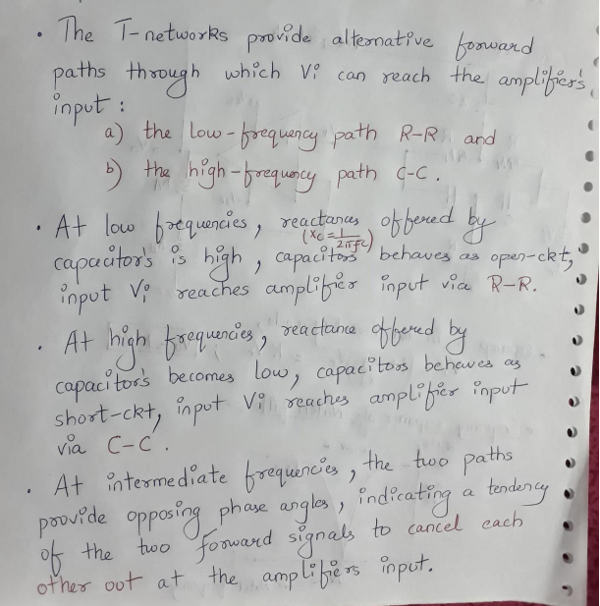

Slide 21
One disadvantage of the passive twin T network is that it has a relatively low figure of merit, Q.
Higher the value of Q, the more selective is the filter. Therefore, to increase the Q of the twin T network sig­nificantly, it should be used with a voltage follower, as shown in Fig.(b)
Fig (c) shows the frequency response of a notch filter.

Slide 22
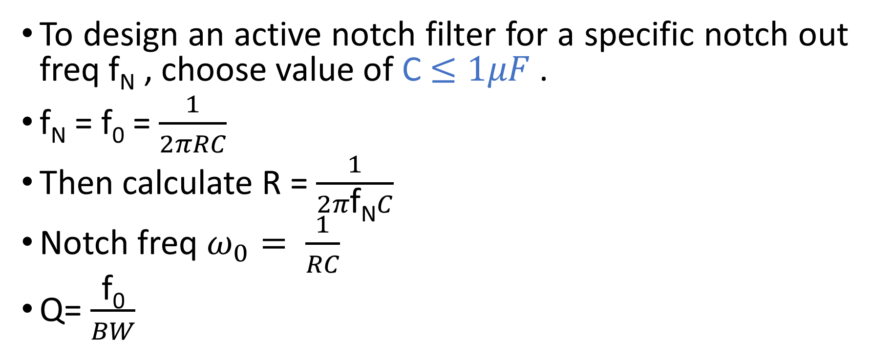
Design
To design an active notch filter for a specific notch out freq f_{N} , choose value of C$≤1μF$.
$\text{f}\text{N}$ = f₀ = $\frac{1}{2πRC}$
Then calculate R = $\frac{1}{2π\text{f}\text{N}C}$
Notch freq $ω_{0}= \frac{1}{RC}$
Q= $\frac{\text{f}\text{0}}{BW}$

Slide 23
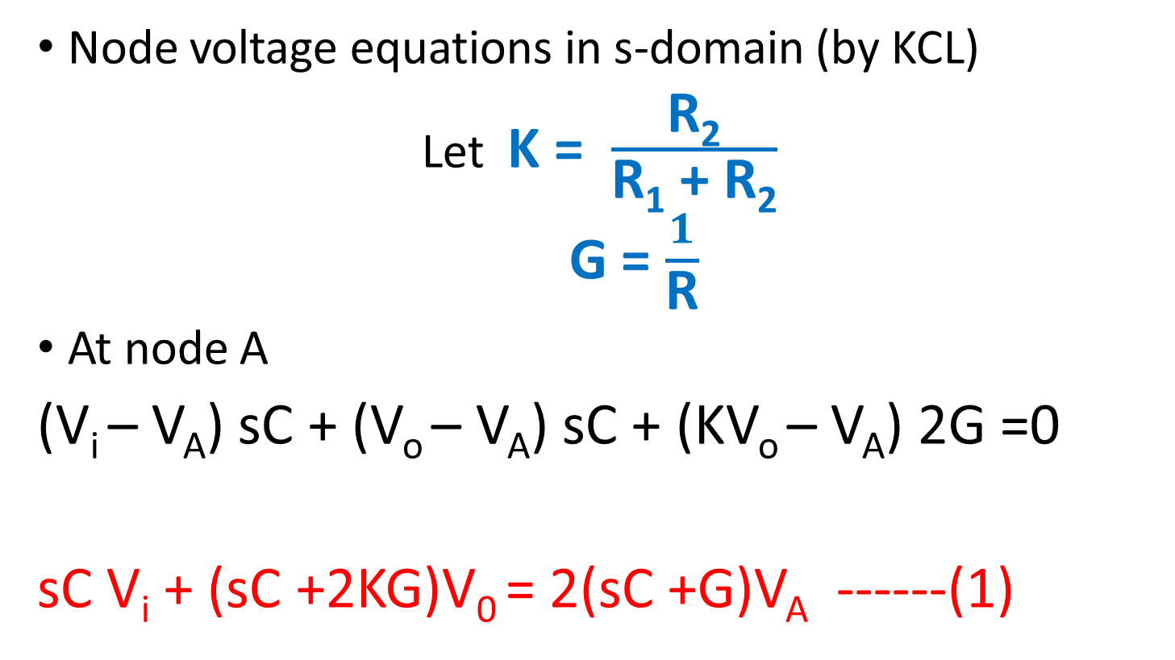
DERIVATION
Node voltage equations in s-domain (by KCL)
Let K = $\frac{\text{R}\text{2}}{\text{R}\text{1}\text{ + }\text{R}\text{2}}$
G = $\frac{1}{\text{R}}$
At node A
(V_{i} – V_{A}) sC + (V_{o} – V_{A}) sC + (KV_{o} – V_{A}) 2G =0
sC V_{i} + (sC +2KG)V₀ = 2(sC +G)V_{A} ------(1)

Slide 24
At node B
(V_{i} – V_{B}) G + (V_{o} – V_{B}) G + 2(KV_{o} – V_{B}) sC =0
G V_{i} + (G+2KsC)V₀ = 2(G+sC)V_{B} ---------(2)
At node P
(V_{A} – V_{o}) sC + (V_{B} – V_{o}) G =0
sC V_{A} + G V_{B} = (G+sC) V_{o} -------- (3)

Slide 25
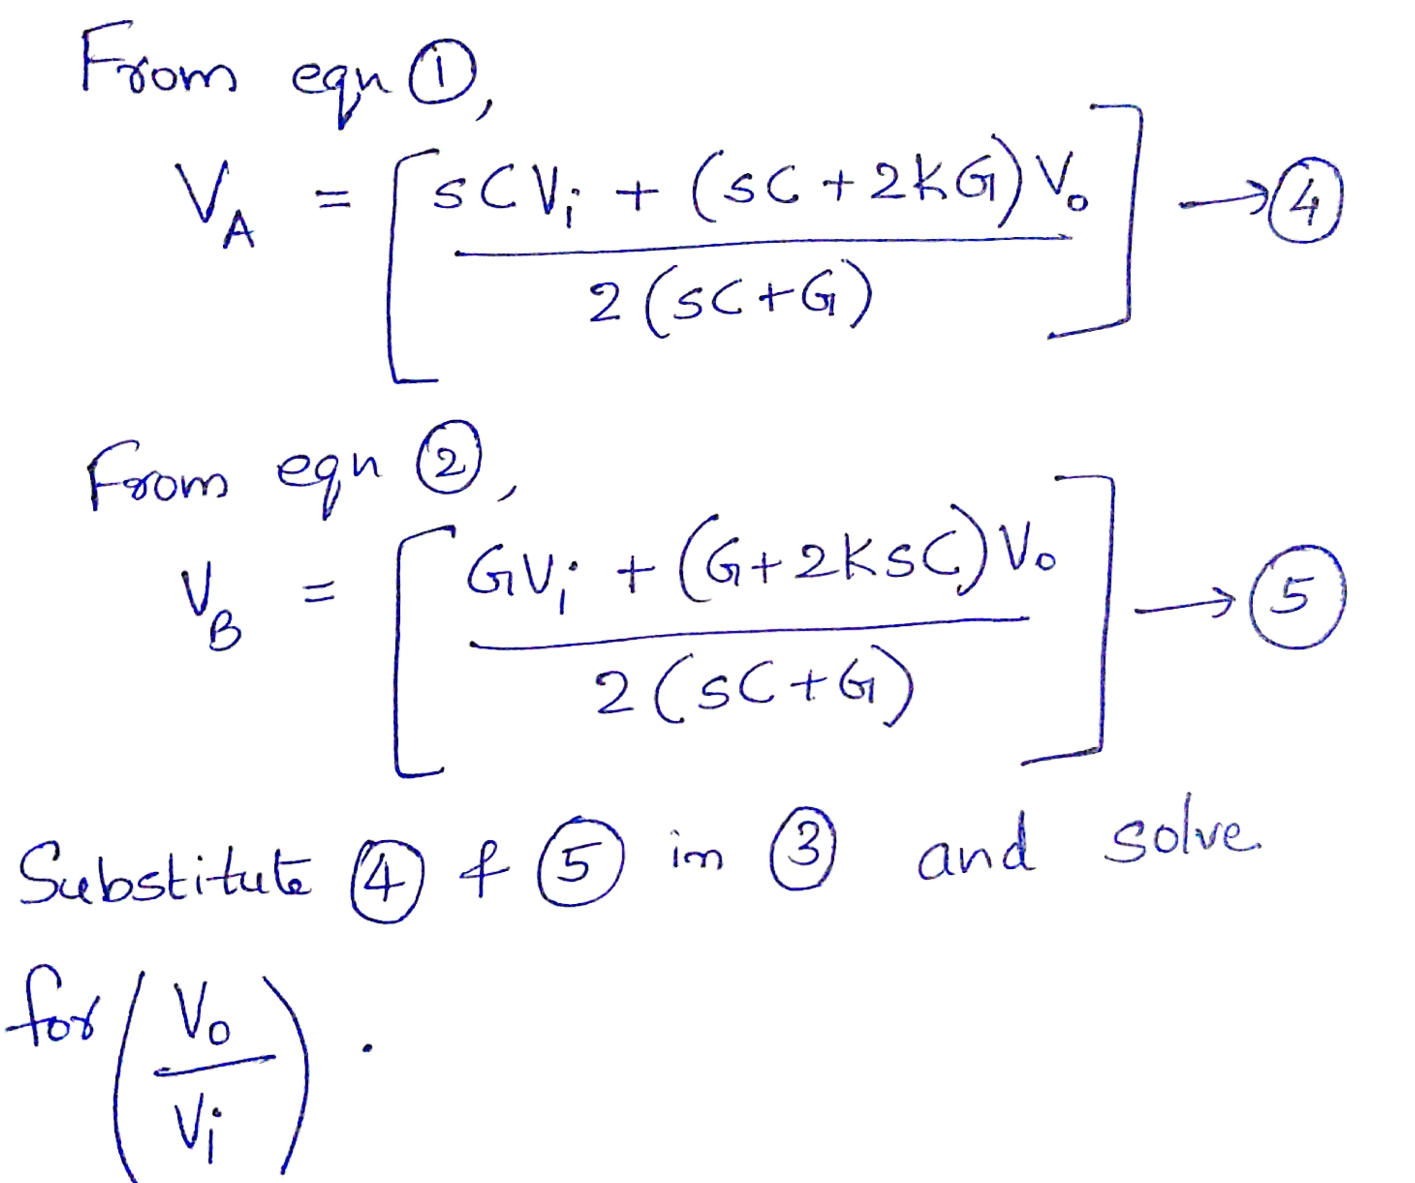

Slide 26
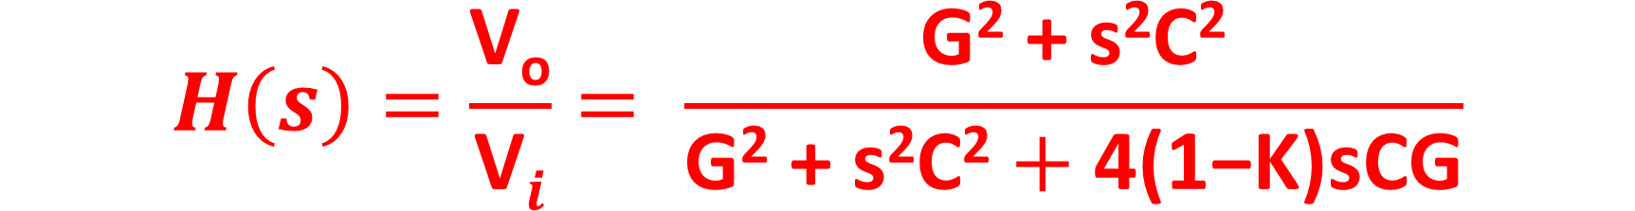
$$H\left(s\right)=\frac{\text{V}\text{o}}{\text{V}i}= \frac{\text{G}\text{2}\text{ + }\text{s}\text{2}\text{C}\text{2}}{\text{G}\text{2}\text{ + }\text{s}\text{2}\text{C}\text{2}+\text{4(1−}\text{K}\text{)}\text{sCG}}$$
---------------(6)

Slide 27
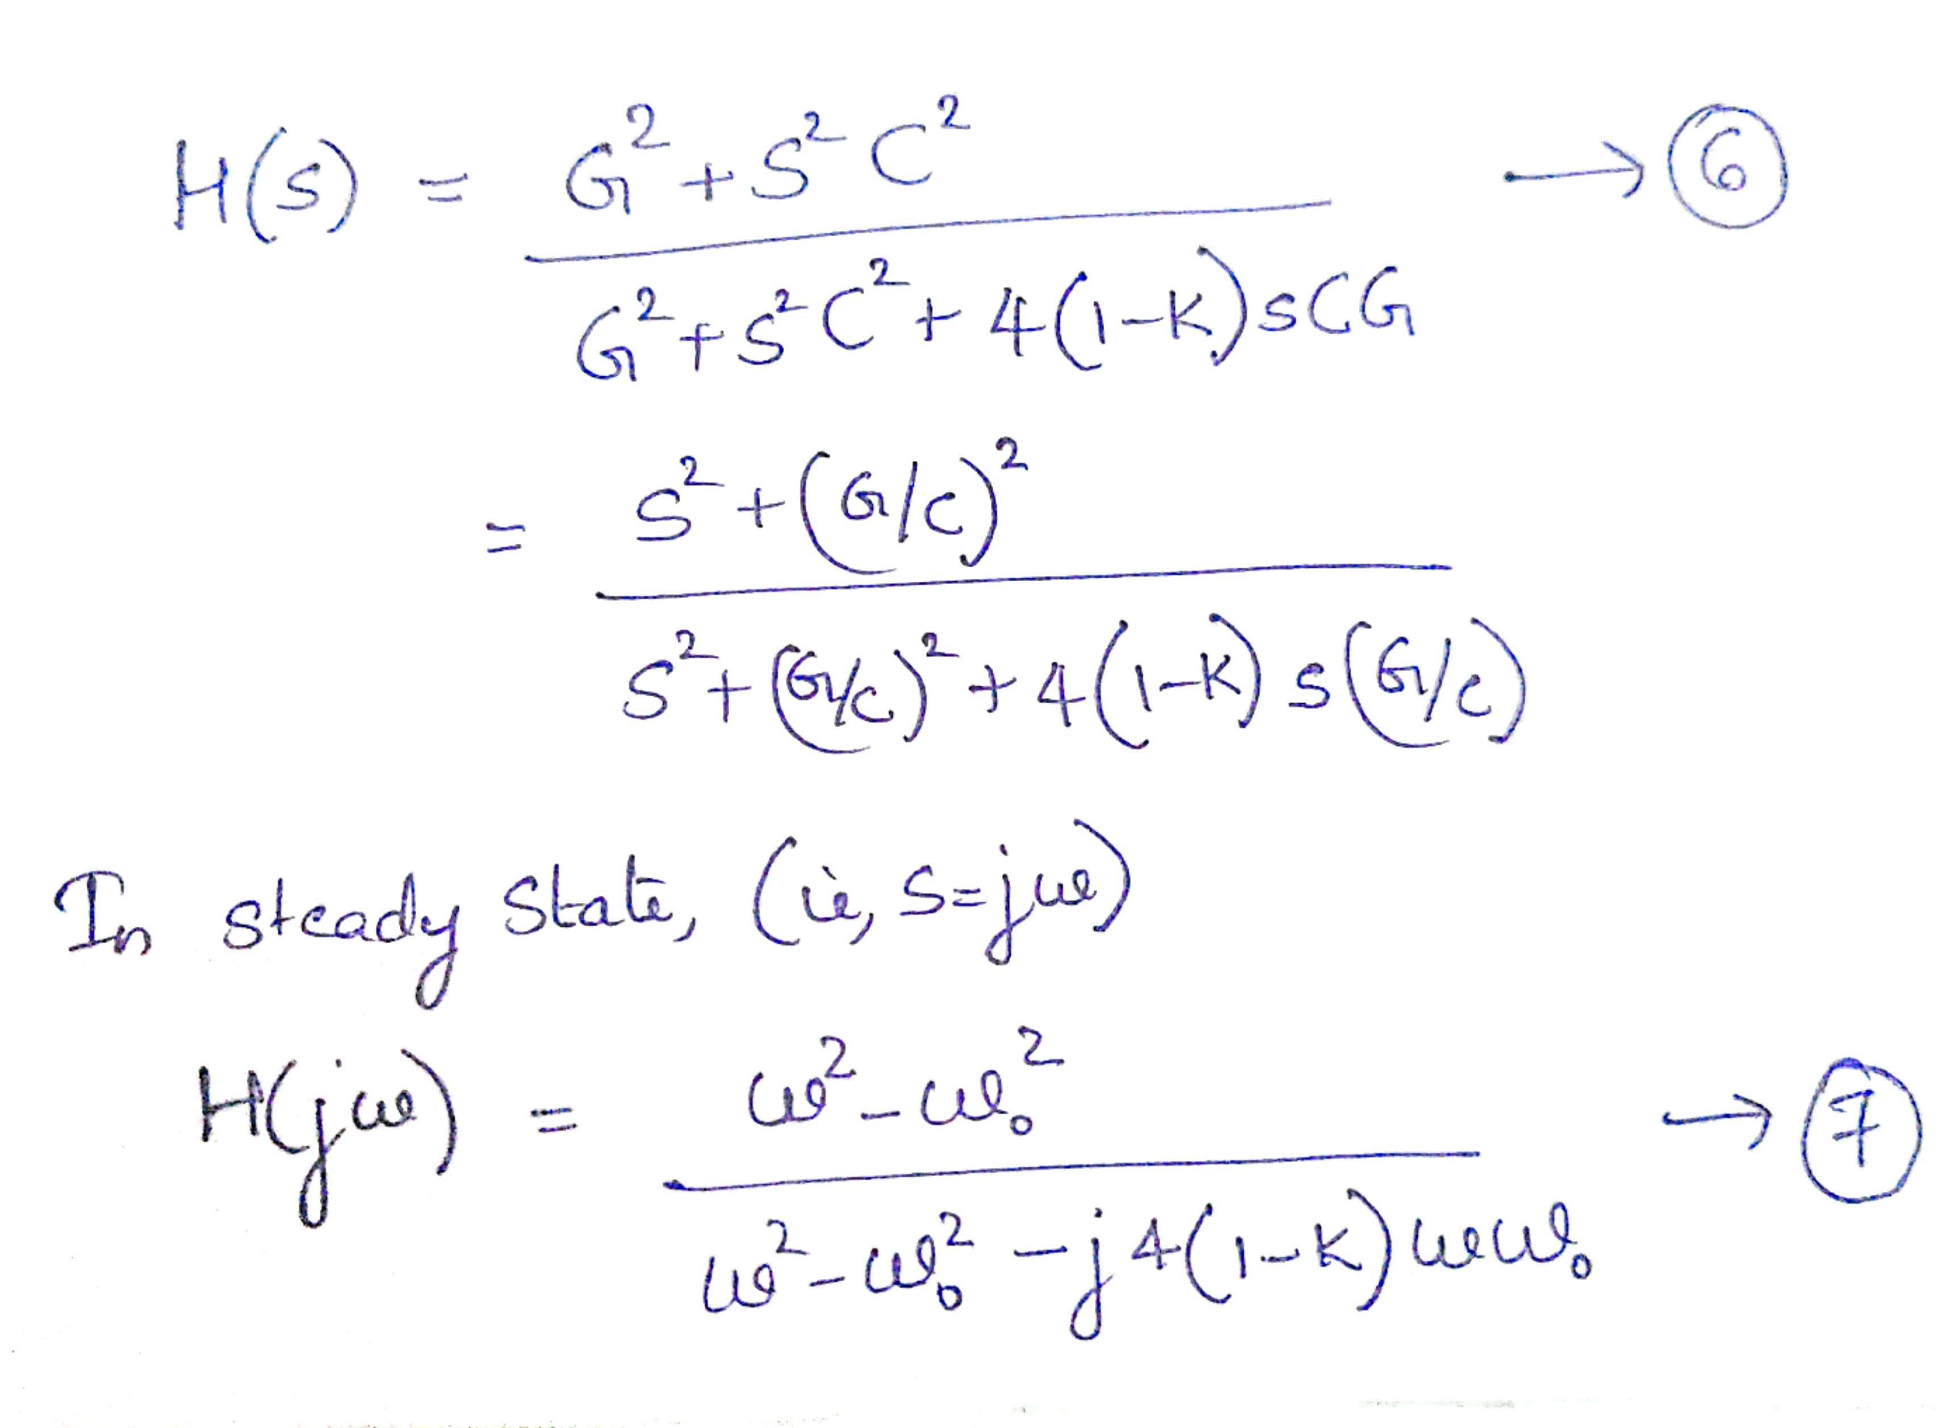

Slide 28
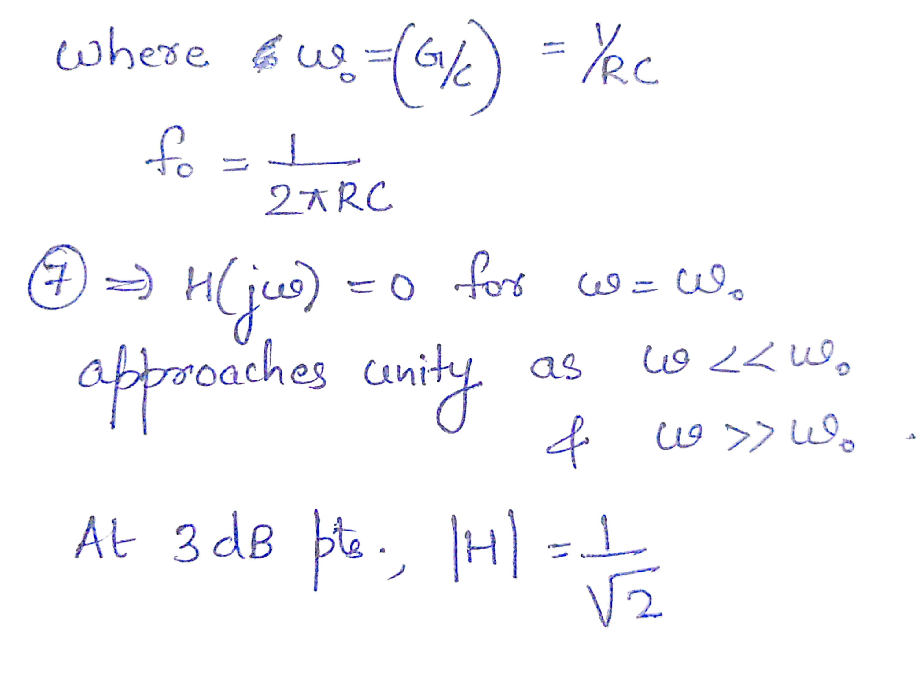

Slide 29
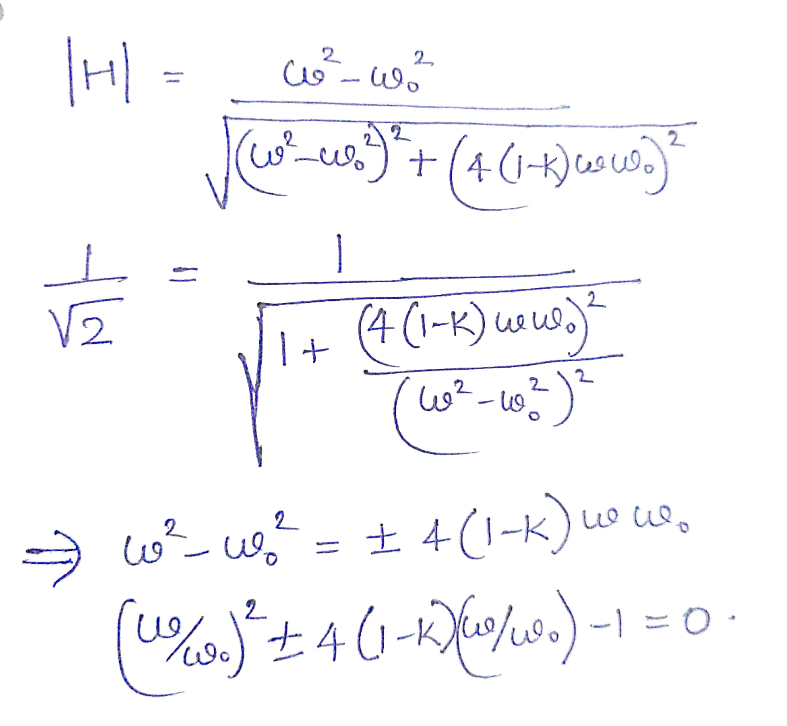

Slide 30
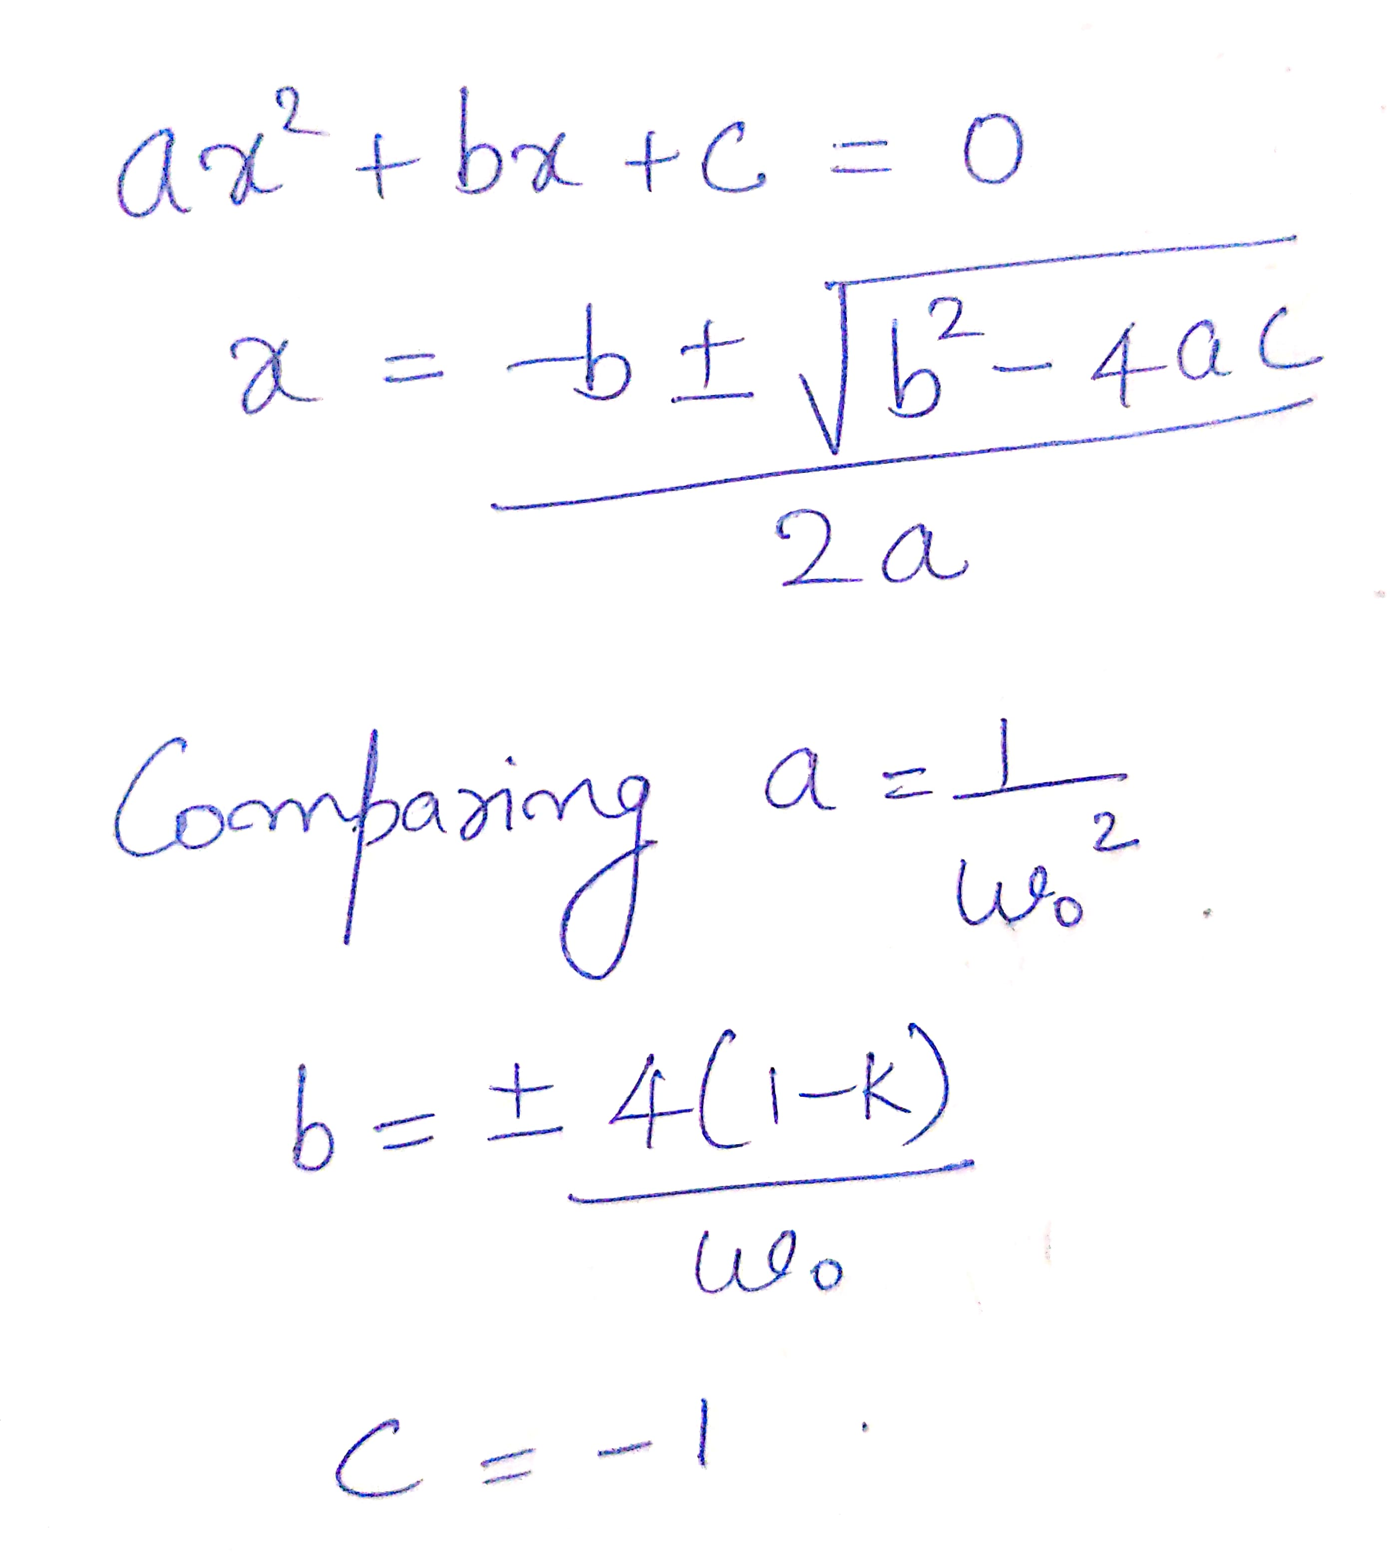

Slide 31
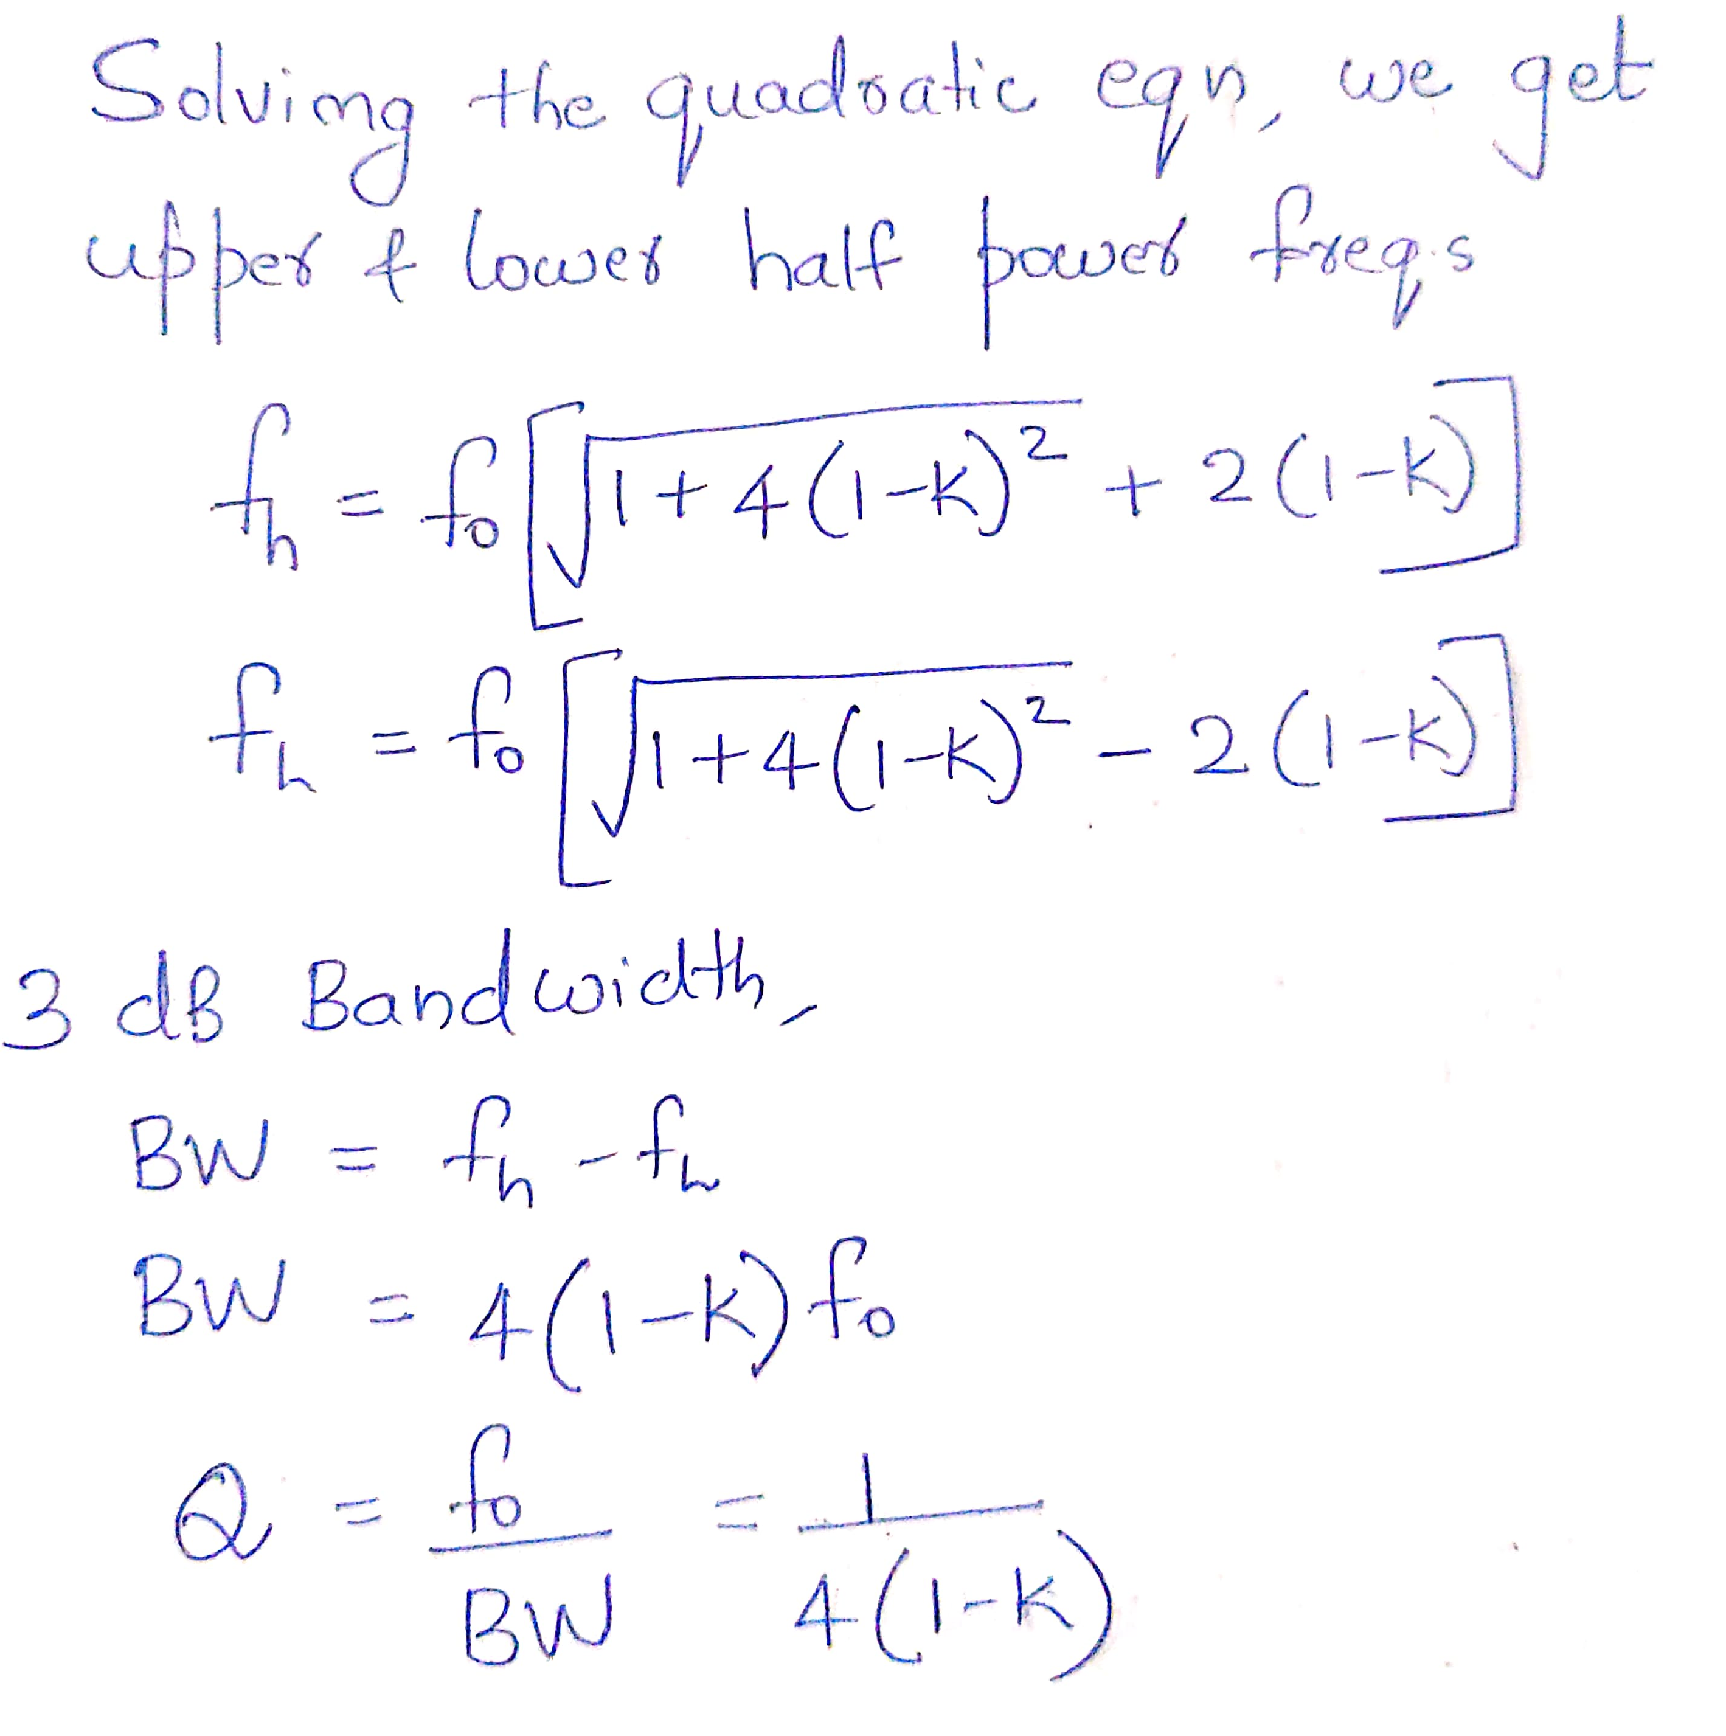

Slide 32
As K approaches unity, Q factor becomes very large and BW approaches 0.

Slide 33
Design a 60Hz active notch filter.

Slide 34
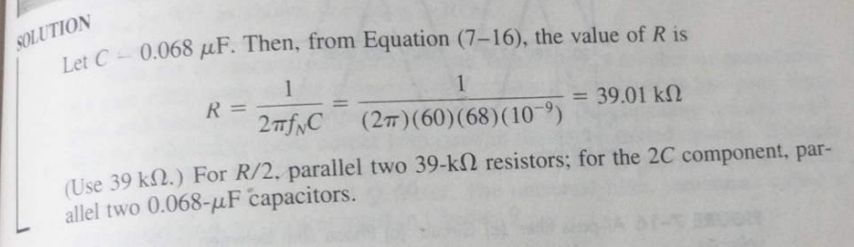

Slide 35
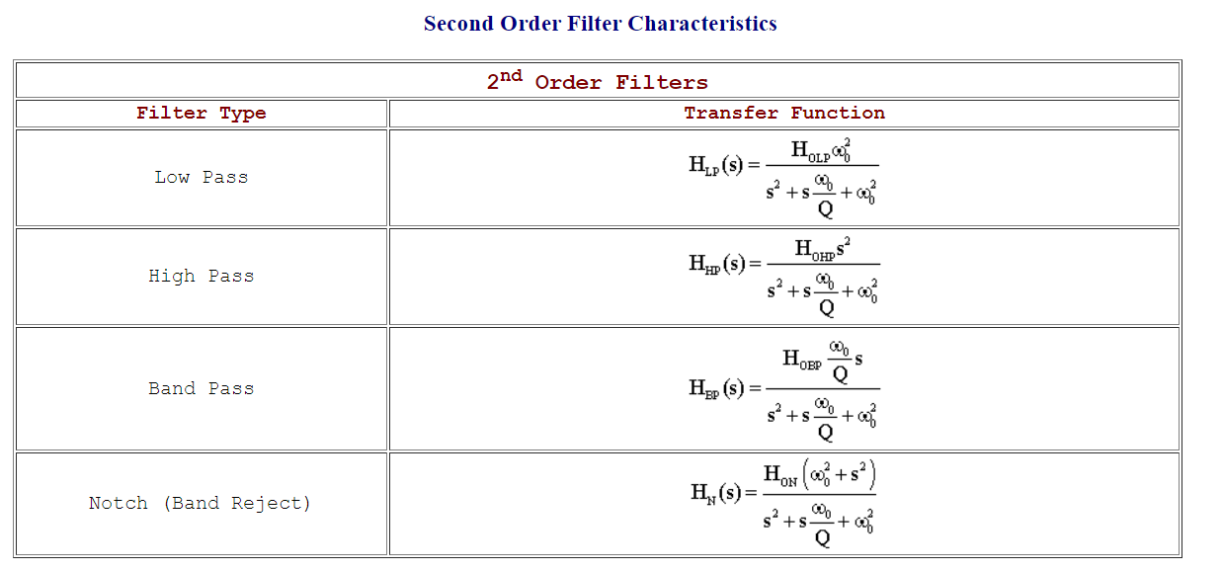

Here $2ξ$ $=α= \frac{1}{Q}$

